Slide 1

ME 200 Thermodynamics
Lecture 11 – Steady State Open System

Slide 2
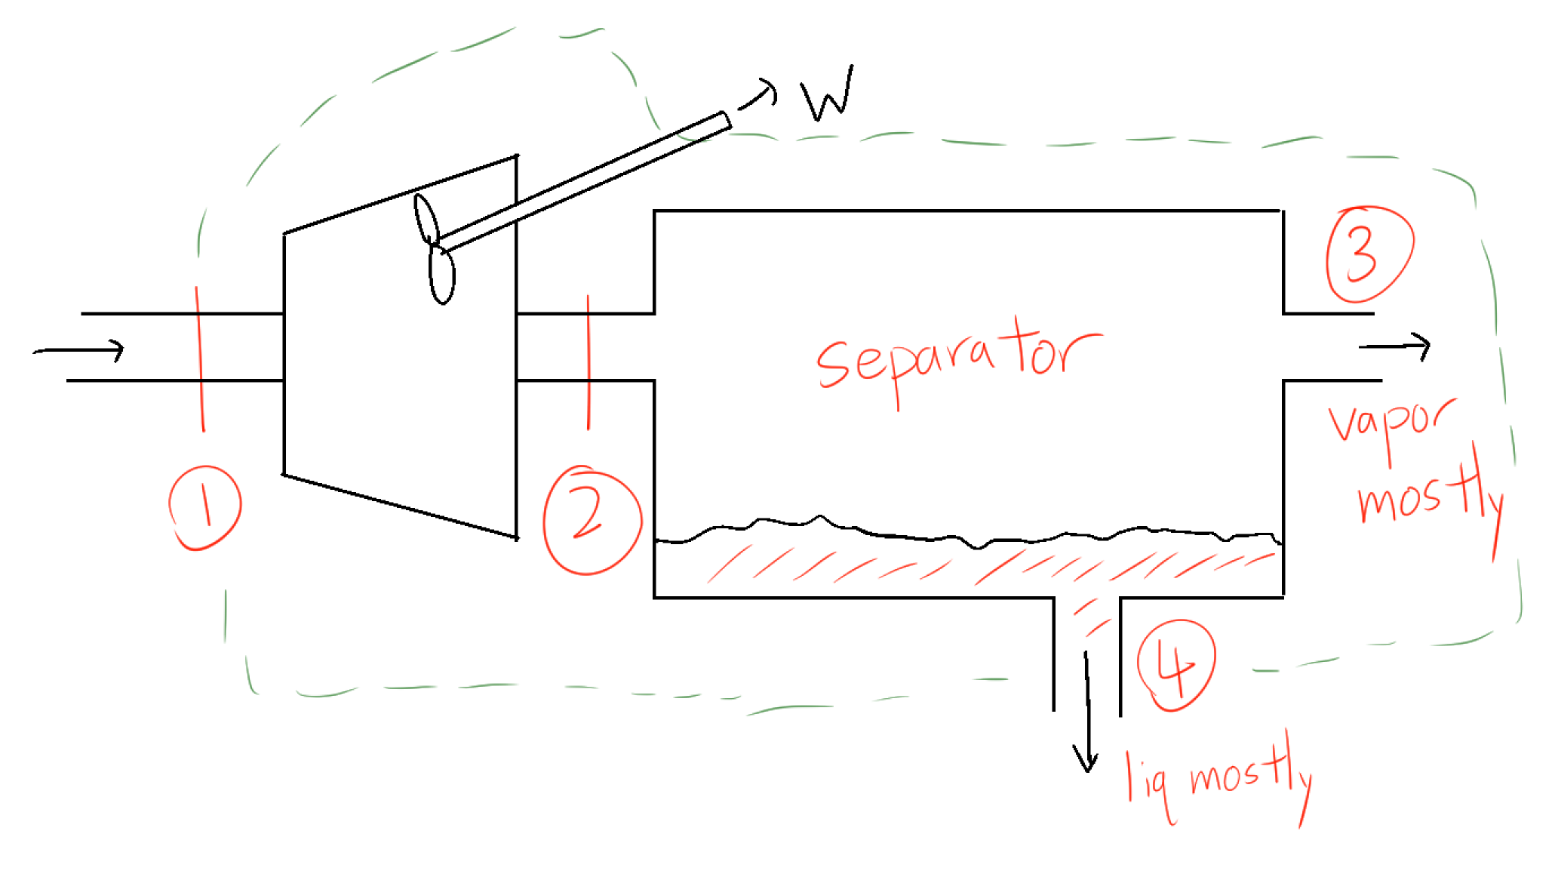
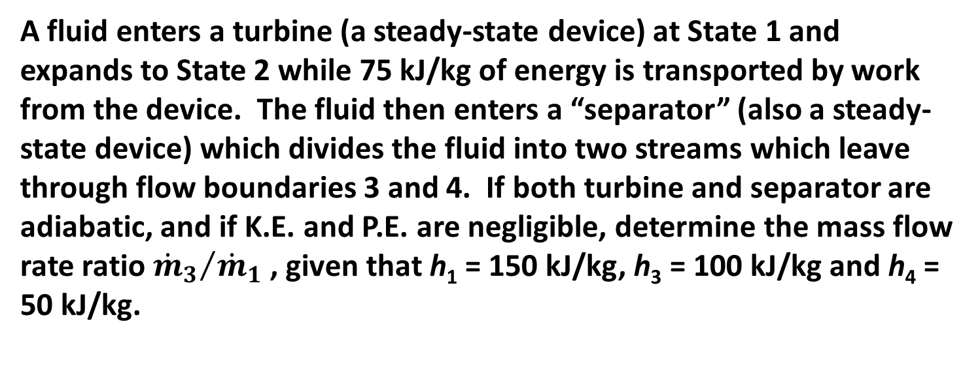
Steady-State Open System Example
A fluid enters a turbine (a steady-state device) at State 1 and expands to State 2 while 75 kJ/kg of energy is transported by work from the device. The fluid then enters a “separator” (also a steady-state device) which divides the fluid into two streams which leave through flow boundaries 3 and 4. If both turbine and separator are adiabatic, and if K.E. and P.E. are negligible, determine the mass flow rate ratio ${{\dot{m}}_{3}}/{{\dot{m}}_{1}}$ , given that h₁ = 150 kJ/kg, h₃ = 100 kJ/kg and h₄ = 50 kJ/kg.

Slide 3
Summary
Steady-state steady-flow (SSSF) processes are processes in which
Open system will normally require both mass and energy conservation equations to be used together.
Conservation equations can be applied to the whole process (e.g., turbine and separator together) or to any individual component.

Slide 4
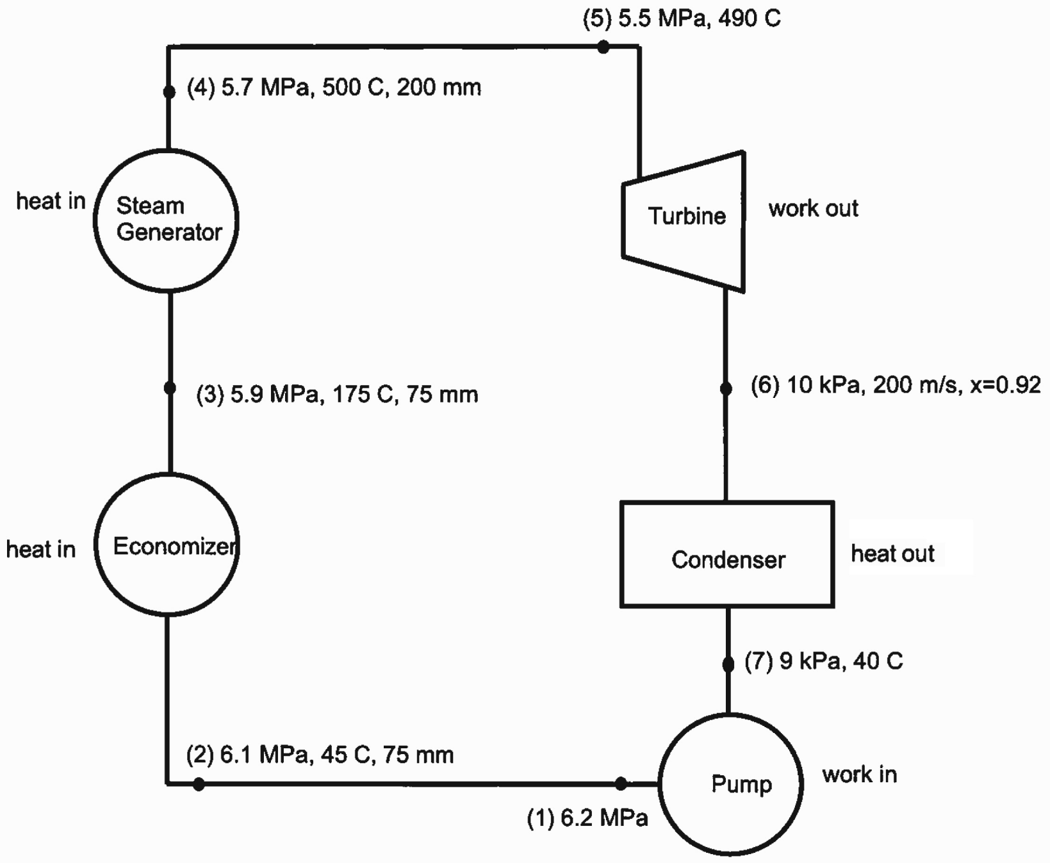


Analysis of a Typical Power Cycle
$$\dot{m}$$

Slide 5
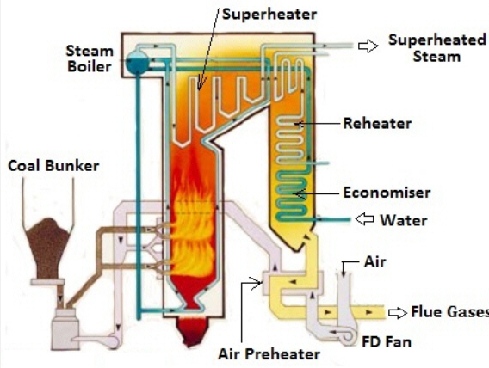
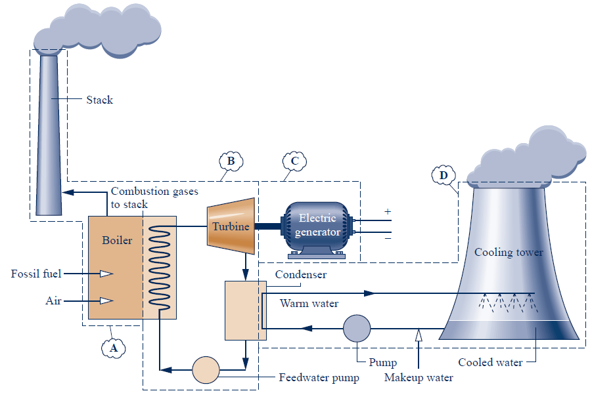
Analysis of a Typical Power Cycle

Slide 6
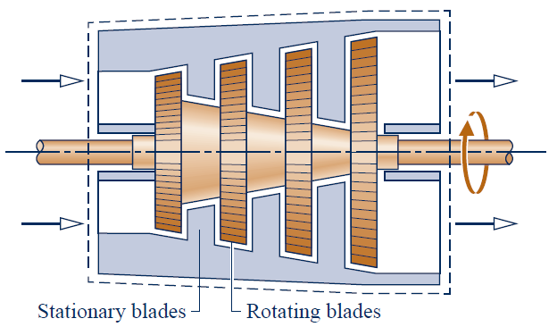
Steam Turbine Operation
After steam passes through turbine, what will happen?
p ↑, T ↑, & V (velocity) ↑
p ↓, T ↓, & V ↑
p ↓, T ↓, & V ↓
p ↓, T ↑, & V ↑
p ↓, T ↑, & V ↓
Notes:
2 minutes
B is the answer (but not always)
C is the purpose, but typical steam turbine V increases

Slide 7
Analysis of a Typical Power Cycle
a) Determine the power output from the turbine.
Turbine basic principles of operation:
Pressure is
Velocity is
Work transfer from the system
Assumptions for turbine analysis:
Steady state
Adiabatic boundaries
Equilibrium states at inlet and outlet
Mass average velocities adequate for calculations
No heat losses
Changes in potential energy are negligible.

Slide 8
Analysis of a Typical Power Cycle
Notes:
Look at state 5 and state 6

Slide 9
Analysis of a Typical Power Cycle
a) Determine the power output from the turbine.
Notes:
D

Slide 10

Analysis of a Typical Power Cycle
a) Determine the power output from the turbine.
$$P_{5}=5.5 MPa, T_{6}=490℃$$
h₅ ≈ _____ kJ/kg
3320
3380
3400
3428
3435
Notes:
3 minutes
D is not the correct answer

Slide 11
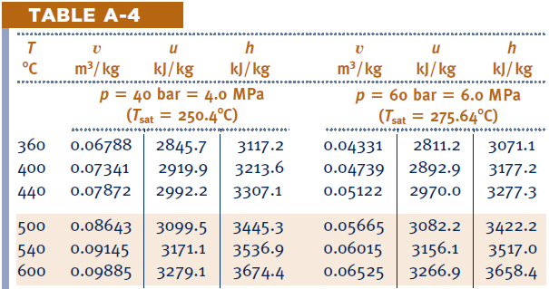

Analysis of a Typical Power Cycle
a) Determine the power output from the turbine.
$$P_{5}=5.5 MPa, T_{6}=490℃$$
Notes:
Need double interpolation. Two ways to do this.

Slide 12
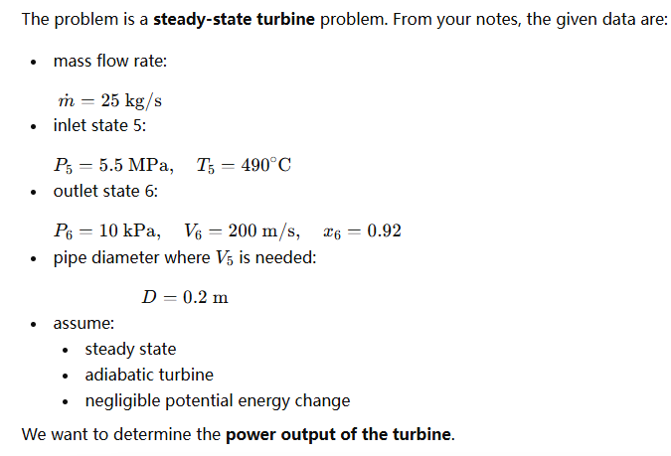

Slide 13
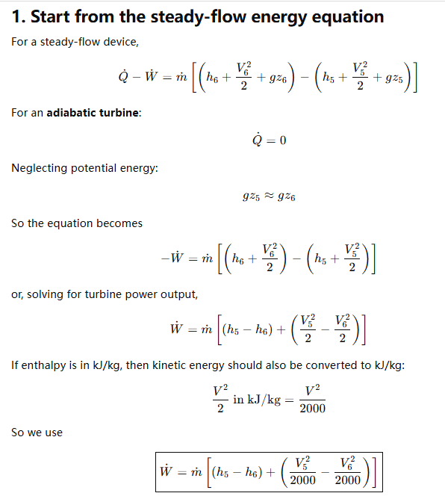

Slide 14
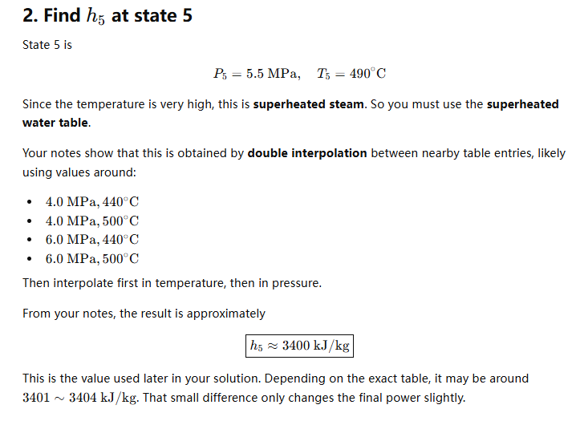

Slide 15
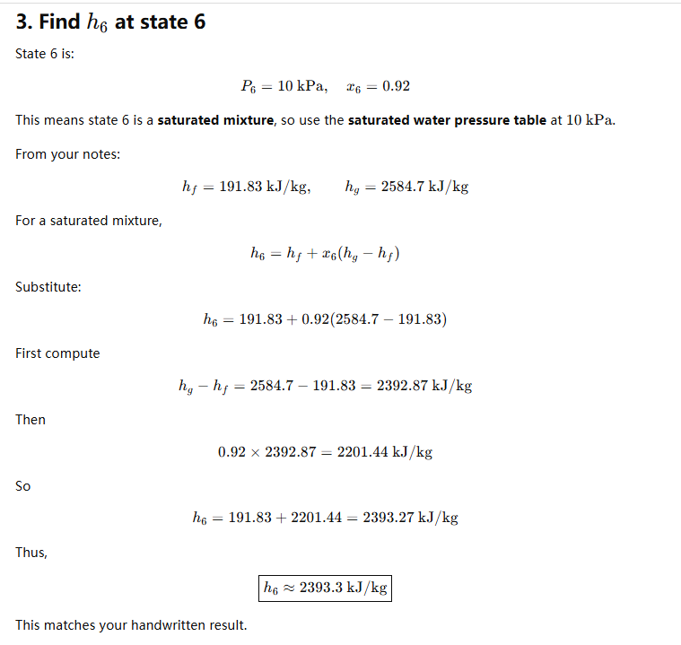

Slide 16
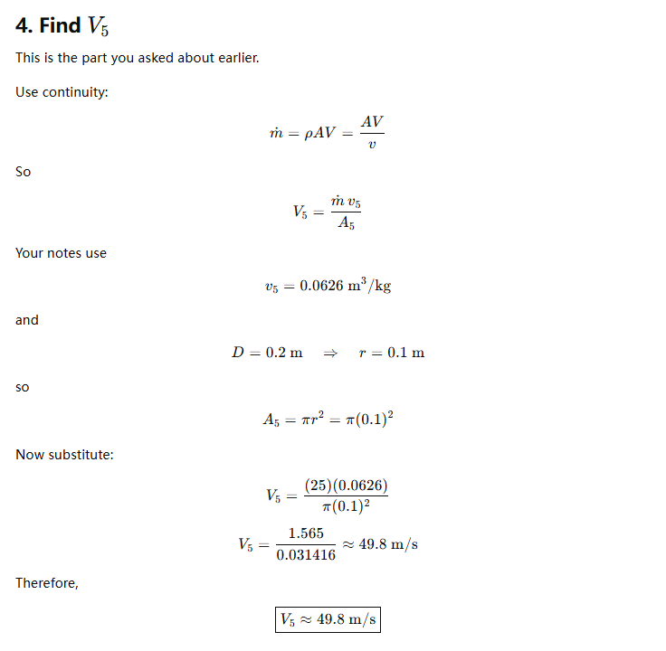
From state 4 in the schematic

Slide 17
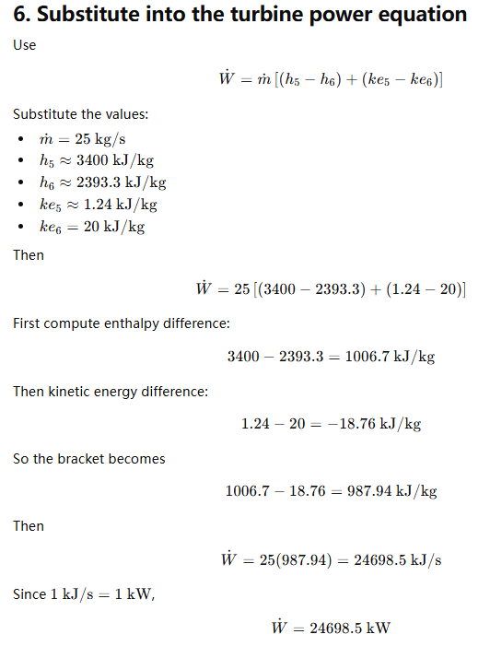
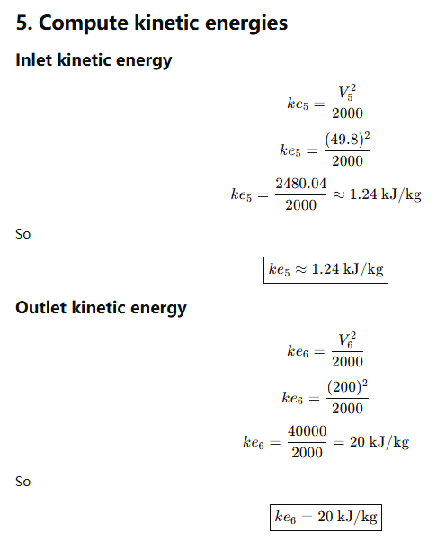

Slide 18
Analysis of a Typical Power Cycle

Slide 19
Steam Generator - Boiler
Notes:
Reheater in the future, can calculate yourself economizer.

Slide 20

Analysis of a Typical Power Cycle
b) Determine the heat transfer rates in the steam generator (practice on economizer yourselves).

